Slide 1
Optimisation of Perioperative Cardiovascular Management to Improve Surgical Outcome II (OPTIMISE II) Trial
Site Initiation Presentation
Southampton General Hospital
20-March-2017
Notes:
1
1
1
Hello and welcome to the OPTIMSE II Trial Site Initiation Presentation.
Just to let you know all these slides will be available on our website.

Slide 2
OPTIMISE II CONTACTS
Role | Name
Chief Investigator | Rupert Pearse
Deputy Chief Investigator | Mark Edwards
Research Manager | Priyanthi Dias
CTU Trial Manager | Ann Thomson
OPTIMSE II Website: optimiseii.org
Contact email: admin@optimiseii.org
Follow us on Twitter: @OPTIMISE2trial
CTU: Pragmatic Clinical Trials Unit (QMUL)
Sponsor: Queen Mary University of London
Database: Online with in-built randomisation
Funders: NIHR and Edwards Lifesciences
National: Leadership team in each country
Notes:
These are some key contacts on the trial. For any trial related queries please email .
Updates on the trial can also be found on the trial website along with all the study documentation and we are also on twitter.

Slide 3
THE PROBLEM
Postoperative complications:
are a frequent occurrence among patients undergoing major gastrointestinal surgery.
- often lead to reduced long-term survival.
Notes:
Post-operative complications are a common occurrence among patients undergoing major gastrointestinal surgery often leading to increased length of hospital stay and reduced long-term survival and quality of life. As a result any kind of improvement in peri-operative care may therefore have substantial impact on the patient and public health.

Slide 4
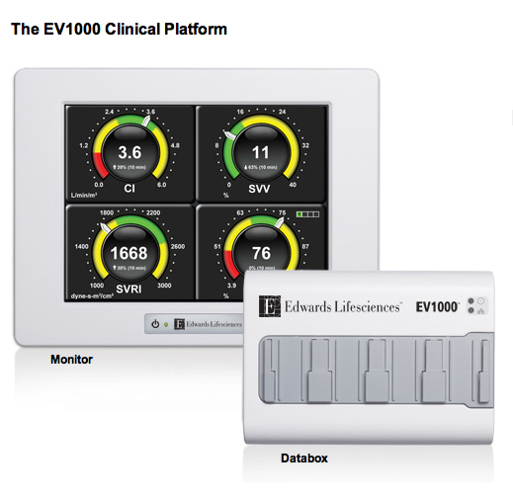
CARDIAC OUTPUT MONITORING
Now much less invasive
Simple to use (nurse led)
Reduced cost
Safe
Notes:
One possible approach to improve patient outcomes is goal directed haemodynamic therapy using CO monitoring to guide IV fluids and ionotropic therapies. The technique has shown to modify inflammatory pathways, and improve tissue perfusion and oxygenation (work done by Rupert’s group).
This approach can be used as standard of care but there is a wide variation in clinical practice.
The monitors are much less invasive, simple to use and safe. However much of evidence demonstrating the benefits of using the monitor have come from small trials.

Slide 5
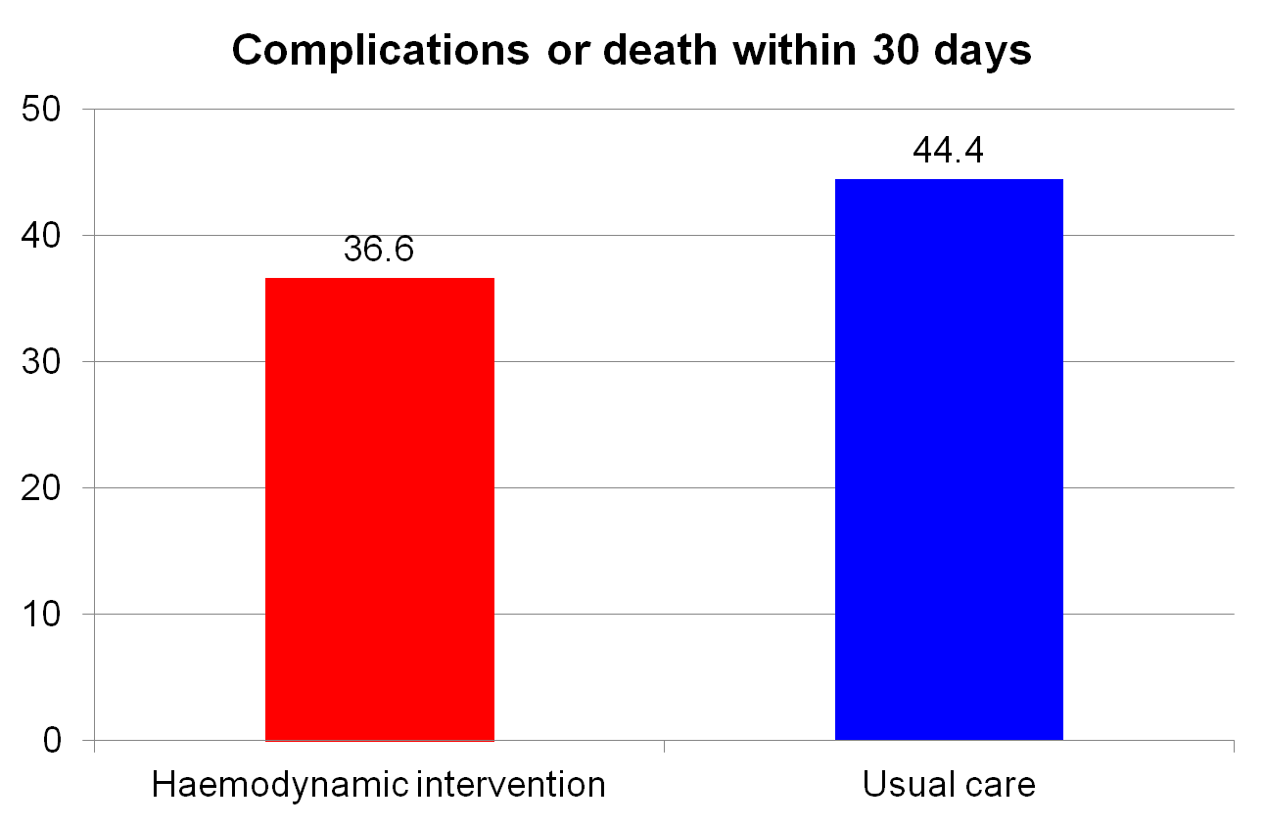
OPTIMISE I PRIMARY OUTCOME
Relative risk
0·84 (0·71-1·01)
P=0.070
Pearse et al. JAMA 2014; 311: 2181-90.
Notes:
And the largest of these trials was the first OPTIMISE study. The primary outcome data demonstrated a clinical effect of reduction in post-operative complications at 30 days in the intervention group compared with the usual care, however these findings were not statistically significant. And do not provide a definitive answer on the benefits of this treatment approach.
Possibly because the trial was under-powered. Complication rate in usual care group would be higher based on previous data (50%); recruited a lots of ASA1/2 patients so signal was less obvious.

Slide 6
TRIAL OBJECTIVE
Does the use of cardiac output monitoring to guide administration of intra-venous fluid and inotrope infusion, for patients undergoing major elective surgery reduce postoperative infection within 30 days of surgery.
Notes:
On the back of OPTIMISE I, this current trial looks at GDHT on a pragmatic scale.

Slide 7
TRIAL DESIGN
International multi-centre randomised controlled trial.
Sample size = 2502 patients (1251 per arm).
Elective surgery only.
50 sites (UK, Germany, US, Canada, Australia and Spain).
Notes:
OPTIMISE II is a large international multicentre randomised controlled trial with open study group allocation for hospitals undertaking elective intra-peritoneal surgery in participating countries.
Recruitment will mostly be split between the UK, Germany, Sweden, US, Canada, Australia and Spain (approx. 10 sites per country) making the results more applicable.

Slide 8
TRIAL PATHAWAY
Day of surgery
Confirm consent
Randomisation
Baseline data
Intervention
Outcomes
- 180 days
Pre-assessment clinic
Screening
Patient information sheet
Written consent/ EQ-5D
During Surgery
- Intervention Data
Outcomes
- 30 days
Outcomes
- 24 hours
Notes:
This is an overview of our trial pathway and would like to go through all the steps. As we want to avoid consent on the day of surgery, in most instances patients will be screened and approached in the pre-assessment clinic. Copy of Patient Information Sheet, Written Informed Consent.
However provided that all reasonable efforts have been made to identify a potential participant 24 hours before surgery, they will still be eligible for recruitment within a shorter time frame if this has not proved possible.
Don’t randomise until you’re sure that the patient is in the anaesthetic room and will receive the intervention if randomised to the treatment.
The first approach should be by the research team in the pre-assessment clinic nurse or doctor, surgeon in the surgical outpatient clinic etc.
However, recruitment of patients on the morning of surgery should be “the exception rather than the rule”
Screening log – Please include patients you would have thought to approach for the trial.
Informed Consent:
Principal Investigator or delegate
Explain study aims, methods and benefits/risks
Copy of Patient Information Sheet
Written Informed Consent
Consent must be confirmed verbally on day of surgery
Any one taking consent needs to have appropriate training, including Good Clinical Practice for Research and be recorded on the site delegation log.
Patients who lack capacity to give or withhold informed consent will not be recruited.
Remember – Copies of the ICF and PIS need to go in the patient notes AND copy of the ICF goes to the patient. The ORIGINAL consent form should be stored in the investigator site file.

Slide 9
RECRUITMENT
Identify patients in the pre-admission or surgical outpatient clinic.
Written informed consent must be obtained before surgery.
Keep a log of all the patients screening for participation.
Aim to recruit 50 participants per site.
Notes:
Screening log – Please include patients you would have thought to approach for the trial.
Informed Consent:
Principal Investigator or delegate
Explain study aims, methods and benefits/risks
Copy of Patient Information Sheet
Written Informed Consent by the research team. Any one taking consent needs to have appropriate training, including Good Clinical Practice for Research and be recorded on the site delegation log.
Consent must be confirmed verbally on day of surgery
Patients who lack capacity to give or withhold informed consent will not be recruited.
Remember – Copies of the ICF and PIS need to go in the patient notes AND copy of the ICF goes to the patient. The ORIGINAL consent form should be stored in the investigator site file.

Slide 10
INCLUSION CRITERIA
Age ≥65 years.
Major elective surgery involving the gastrointestinal tract that is expected to take longer than 90 minutes.
Notes:
Patients aged 65 and over. Major surgery which is expected to last longer than 90 minutes and involves the gastrointestinal tract.

Slide 11
EXCLUSION CRITERIA
Inability or refusal to provide patient consent.
Clinician refusal.
American Society of Anesthesiologists (ASA) score of 1.
Patients expected to die within 30 days.
Acute myocardial ischaemia within 30 days prior to randomisation.
Acute pulmonary oedema within 30 days prior to randomisation.
Contra-indication to low-dose inotropic medication.
Pregnancy at time of enrolment.
Previous enrolment in the OPTIMISE II trial.
Current participation in another clinical trial of a treatment with a similar biological mechanism or primary outcome measure.
Notes:
As you can see there is a broad list of exclusion criteria but we would like to highlight the key factors. Firstly Clinician refusal – please record the reason for clinician objection. Secondly ASA score of 1. And finally for study co-enrolment we advice this is discussed with our trial team prior to consent to avoid overlap in treatments with a similar biological mechanism or primary outcome measure. Use PRISM as an example.

Slide 12
RANDOMISATION
After informed consent
On day of surgery patient in anaesthetic room
Via the OPTIMISE II online database
Randomisation criteria:
ASA grade
Planned surgical procedure category
Planned level of care on first night after surgery
Laboratory tests (Haemoglobin, Creatinine and Ethnicity)
Notes:
Randomisation will be done by a member of the site research team after informed consent.
It is very important to avoid randomising patients that don’t go on to have surgery. For instance as cancellations can occur on the day of surgery we kindly ask that randomisation only occurs once the patient is in the anaesthetic room.
When the database is up and running sites can register. When registered, you can then click ‘randomise patient’.
Please enter randomisation details as prompted by the form.

Slide 13
INTERVENTION GROUP
Commence at start of general anaesthesia.
OPTIMISE II treatment algorithm.
Fluid guided by stroke volume/ low dose inotrope infusion.
Low rate maintenance fluid.
Continues for 4 hrs after surgery is complete.
Notes:
The intervention should begin immediately following induction of anaesthesia and continue for 4 hours after surgery but for a maximum of 24 hours. Cardiac output and stroke volume will be measured by cardiac output monitor provided on loan to all participating sites by Edwards Lifesciences. Patients in the intervention group will also receive a low dose inotrope infusion either Dobutamine or dopexamine during the intervention period. Further details on the intervention is provided in our SOP. If monitoring has been used for less than 80% of the intervention period this meets the definition of a protocol deviation and should be reported as such.

Slide 14
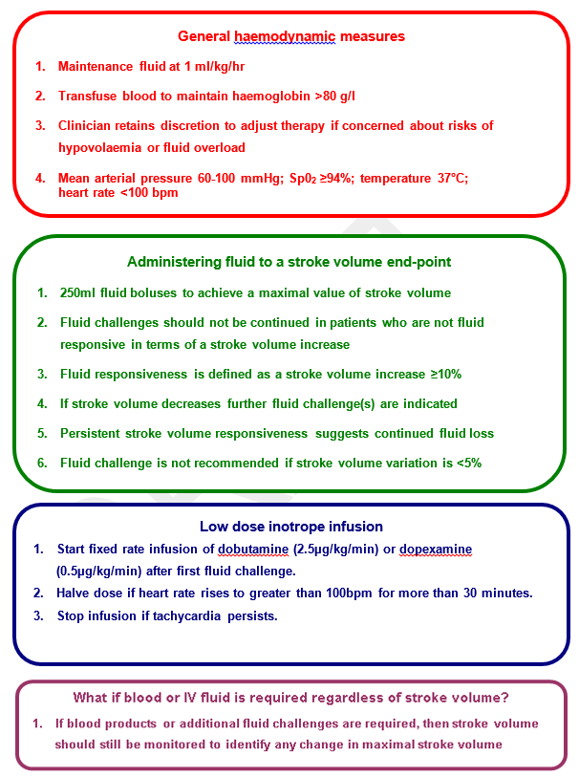
OPTIMISE II treatment algorithm
Notes:
Handout – laminate
Haemodynamic algorithm.

Slide 15
USUAL CARE GROUP
Usual perioperative care
Broad criteria to emphasise good care
Avoids practice misalignment
No cardiac output monitoring
Notes:
Patients will be managed by the care team according to usual practice. Patients should not be randomised if the clinician intends to use cardiac output monitoring regardless of study group allocation; this is considered ‘clinician refusal’ and is a specific exclusion criteria.
However, clinical staff are free to request cardiac output monitoring if this is required to inform the treatment of a patient who becomes critically ill (e.g. because of severe haemorrhage) during the trial intervention period. In this situation a protocol deviation form will be completed.

Slide 16
OUTCOME MEASURES
Primary: Post-operative infection within 30 days of surgery
Secondary: 180-day mortality
Acute Kidney Injury
Quality Adjusted Life Years
Cardiovascular events
Notes:
Discuss why infection and give examples

Slide 17
PATIENT FOLLOW-UP
Review patient’s medical records (paper or electronic) and contact them on the telephone to conduct brief interviews at 30 days and 180 days after randomisation.
Verified by the PI or designee (blinded to treatment allocation).
After the completion of 180 day follow-up the PI or designee will lock each case so that no further data can be entered.
Notes:
All patients should be followed up throughout the duration of their hospital stay. Primary and secondary outcome data will be collected at 30 and 180 days. We think the best way to collection this information would be by directly speaking to the patient, followed by a contact to the GP and then checking the patient’s hospital records. We also need to speak with the patient to collect the EQ-5D(3L) standardised health status questionnaire required for our health economics analysis. All SAEs should be recorded within the 30 day f/up.
Simple descriptive profile and index value for health status. Ask the patient each question on the list and record the appropriate answer on the CRF.

Slide 18
Questions…..?

Slide 19
CASE REPORT FORM (CRF) COMPLETION
Accurate Study IDs and Patient Initials on ALL documentation.
Timely and accurate data entry.
Entered into eCRF.
Logins to access the eCRF will be issued by the trial team.
Notes:
Data should always be documented in the research notes so they don’t get lost. Monitor should be able to reproduce CRF from patient notes (both eCRF and paper).
Data Entry Timeline – we recommend on the same day, but at least within a week or before the patient is discharged.

Slide 20
MINIMISING BIAS
Follow-up will be conducted by a member of research staff who is unaware of trial group allocation.
Complications will be verified by the local PI or designee who is unaware of trial group allocation.
Notes:
It would be sensible to keep a log of the investigator that randomises +/- helps with the trial intervention, so that the follow up can be done by a team member who is unaware of trial group allocation.
That this is an open-label trial, however, procedures are in place to minimise the possibility of bias arising because research staff become aware of treatment group allocation. There is a field in the CRF which will be used to assess the possibility of observer bias.

Slide 21
SELF-ASSESSMENT OF BLINDING
To quantify the degree of blinding, research staff will make a self-assessment of blinding when collecting follow-up data.
Grade as one of the following options:
Suitably blinded
May have known study group allocation
Definitely knew study group allocation
Notes:
that this is an open-label trial, however, procedures are in place to minimise the possibility of bias arising because research staff become aware of treatment group allocation. There is a field in the CRF which will be used to assess the possibility of observer bias.

Slide 22
PROTOCOL DEVIATIONS
Participant in the intervention group did NOT receive cardiac output monitoring.
Participant in the intervention group did NOT receive inotrope infusion, or received incorrect dose.
Participant in the control group DID receive cardiac output monitoring.
Notes:
Record in the CRF supplementary form – protocol deviations.

Slide 23
WITHDRAWAL
All study participants are free to withdraw from the study at any time.
All randomised patients will be included in the final analysis on an intention to treat basis, unless they specifically ask for their data not to be included.
Record details using withdrawal form.
Notes:
Withdrawal from the study will be defined by no data collection taking place past the point of withdrawal.
Participants must be asked whether we can still use data up to that date, or whether they would like their data removed from the database.
Patients should be encouraged to allow their data to continue to be collected following withdrawal – although obviously they are, of course, allowed to refuse this.
If a patient is found to be ineligible following randomisation, discontinuation form must be completed to that effect.

Slide 24
ADVERSE EVENTS
OPTIMISE II is a non-CTIMP trial, and all trial interventions are already in routine clinical use for patients undergoing major gastrointestinal surgery. The safety of the intervention will be monitored by recording acute cardiac events at 24 hours and post-operative infections at 30 days after randomisation as a trial outcome. These events will be monitored at intervals by the DMEC and will not be recorded separately as an AE on the CRF.
Notes:
For an adverse event to be classified as serious, it must meet one of the above criteria.
If one of the above criteria is met, and the AE has been assessed by the PI as probably or definitely caused by OPTIMSE, please record as appropriate on the adverse event form and notify the OPTIMSE trial coordinating centre by email within 24 hours of becoming aware of the event. Please use the patient’s trial number and do not include patient identifiable information.
Please also complete the online eCRF and submit for review. The CI will assess and discuss with the PI as required.
Complete a separate form for each adverse event.

Slide 25
SERIOUS ADVERSE EVENTS
Must be assessed by PI (or suitably qualified nominee) as probably or definitely related to the OPTIMSE II trial and meet at least one of the following criteria:
Results in death
Is life threatening
Clearly prolongs hospital stay
Causes significant disability or incapacity
Report SAEs to the trial coordinating centre within 24 hours
Notes:
For an adverse event to be classified as serious, it must meet one of the above criteria.
If one of the above criteria is met, and the AE has been assessed by the PI as probably or definitely caused by OPTIMSE, please record as appropriate on the adverse event form and notify the OPTIMSE trial coordinating centre by email within 24 hours of becoming aware of the event. Please use the patient’s trial number and do not include patient identifiable information.
Please also complete the online eCRF and submit for review. The CI will assess and discuss with the PI as required.
Complete a separate form for each adverse event.

Slide 26
PATIENT IDENTIFIABLE INFORMATION
Will be collected and entered on to the secure data entry web portal.
Is essential for the outcomes of the trial.
Please do not send any patient identifiable information by email to the trial office e.g. name, address, date of birth, hospital number, national insurance number etc. Use only the OPTIMISE trial ID to identify a participant.
Notes:
We will be keeping patient identifiable information on the study database, which is encrypted in line with NHS requirements.
Please don’t send patient identifiable information by email as we do not have a secure email account. Always identify trial participants by trial number.

Slide 27
MONITORING
Each site will receive 3 monitoring visits:
Site initiation visit
After 10 patients recruited or at 1 year, whichever is sooner
Closeout visit
100% Source Data Verification (SDV) for primary outcome at 30 day follow-up for up to 10 patients at each visit.
Possible ad-hoc visits.
Site self assessment for random selection of 20% of patients.
Notes:
SDV = source data verification.
Before the visit we will let you know which patients will be reviewed, to allow you to request patient notes etc.

Slide 28
STUDY PROCEDURES
Screening & Enrolment log to be completed
Investigator Site File (ISF)
Delegation log signed
Standard Operating Procedures (SOPs)
Copies of all investigators CVs & GCP/RGF certificates must be filed in the ISF
Notes:
Screening log must be completed as part of the screening process for OPTIMISE II. There will be a form within the database to complete with summary information. Either keep paper or electronic log with patient details at sites.
Please complete either paper or electronic screening log each time pre-assessment clinic/ theatre lists are checked.
Enrolment log to be completed for each patient enrolled on the trial.
You should have received or about to shortly receive your Investigator site file, this contains all trial related documentation. Any new documents/correspondence will be sent to you by the trial management team and should be filed in the applicable section. If you are missing anything from your file please let the OPTIMISE II Trial manager know so this can be rectified.
Inside the Investigator site file is a delegation log which must be signed by the OPTIMISE II investigators including research team members who are working on the trial. Once this is completed a copy should be sent to the OPTIMISE II trial manager for their records. If any members of your team should leave or any new staff join your team the delegation log should be updated accordingly and a new photocopy sent.
There are a small number of standard operating procedures (SOPs) that must be read by each of these investigators too, they must sign off the OPTIMISE II SOP training log to confirm these have been read and understood.
Copies of all GCPs and CVs should also be filed in the investigator site file (ISF).

Slide 29
TRIAL INITIATION
- When R&D approval is in place and all documentation has been sent to us, the trial can begin.
- Please send the following prior to activation:
Localised patient documentation (PIS, ICF, GP letter)
Signed protocol agreement
PI CV & GCP
R&D approval
Completed delegation log
Signed SIV checklists (at this meeting or after)
The PI must register on the trial database and enter general site information

Slide 30
KEY POINTS
Each site must have regulatory approval
Randomise once the patient is in theatre
Informed consent must be obtained
Timely entry of outcome data collection
Timely entry of CRF data into the eCRF
Please ask questions! ☺
Notes:
Unfortunately cancellations on the day of surgery are common. However, it is very important to avoid randomising patients that don’t go on to have surgery. Please only randomise the patient once you are certain that surgery will go ahead e.g. when the patient is in the anaesthetic room on the day of surgery.
Randomisation criteria – If multiple procedure categories apply, please use the single most appropriate procedure category.
Nee

Slide 31
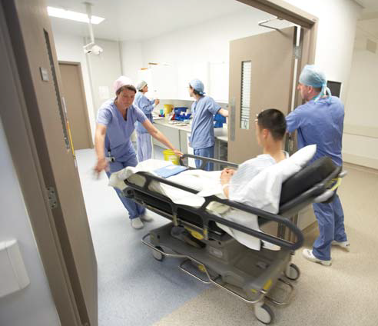
QUESTIONS?

